Slide 1


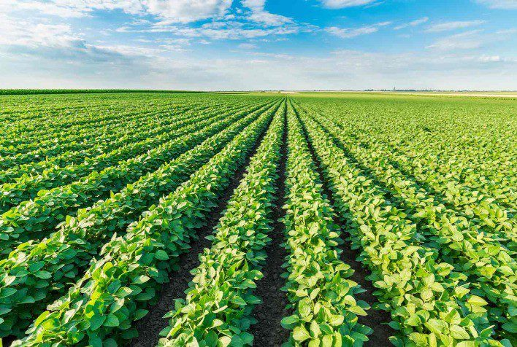
Data Challenge Phase 2
Prediction of soybean crop yields in Madhya Pradesh using machine learning

Slide 2

Table of contents
Introduction
Understanding of the data
Cleaning of the data
Feature selection analysis
Graphical Method
Advanced Method
Time series analysis
Machine learning
Resources
Publish on Ocean Market

Slide 3
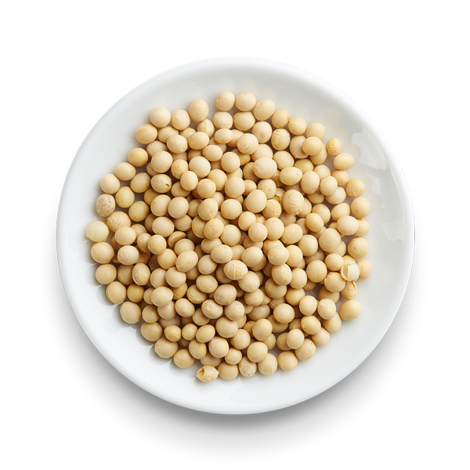

Introduction
The economy of Madhya Pradesh is an agrarian economy, which means that it is mainly based on the production and maintenance of crops and agricultural land. Agricultural yield is therefore a priority for its citizens who depend on it and especially the yield of soybean crops, the second most important crop in this state after wheat. In this sense, the prediction of soybean crops in Madhya Pradesh would be a real progress for agricultural management and farmers. So that is what we are going to do here using data and machine learning.

Slide 4
Understanding of the data
Here are the descriptions and remarks that we can attribute to each feature in order to understand their potential impact on yield :
YIELD : Annual soybean yields by district in tons/hectares (Soybean is sown in June and harvested in November)
NDVI : Normalized Difference Vegetation Index (It allows to determine the health of the vegetation by measuring the chlorophyll content of the plants via sensors embedded on satellites). Here it is not specific to soybean crops.
LAI : Leaf Area Index (It quantifies the amount of leaf material in a canopy). Here it is not specific to soybean crops.
ET : Evapotranspiration (It is the transfer of a quantity of water to the atmosphere, by evaporation from the soil and by transpiration from plants.). Here it is not specific to soybean crops. (in mm per unit time)
LST : Land Surface Temperature (in Kelvin)
RF : Rainfall (in mm/m²)

Slide 5
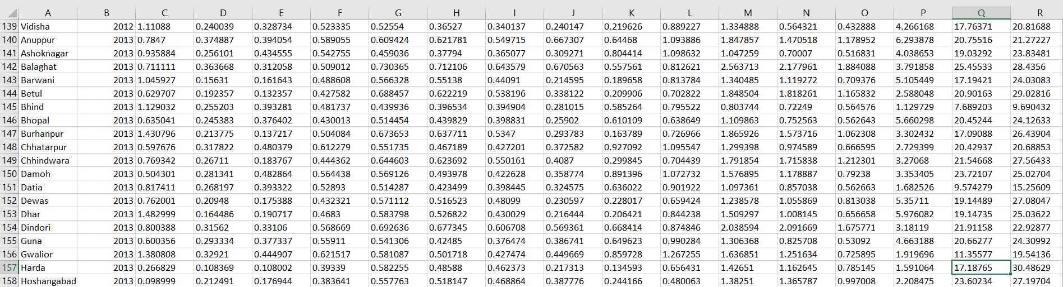
Cleaning of the data
Since the data is already clean, we just need to fill in the only missing data in the dataset. This missing data is the "ET_JUL" feature of the Harda district in 2013. So I replaced it with the average of the ET_JUL of this district for the other years :

Slide 6
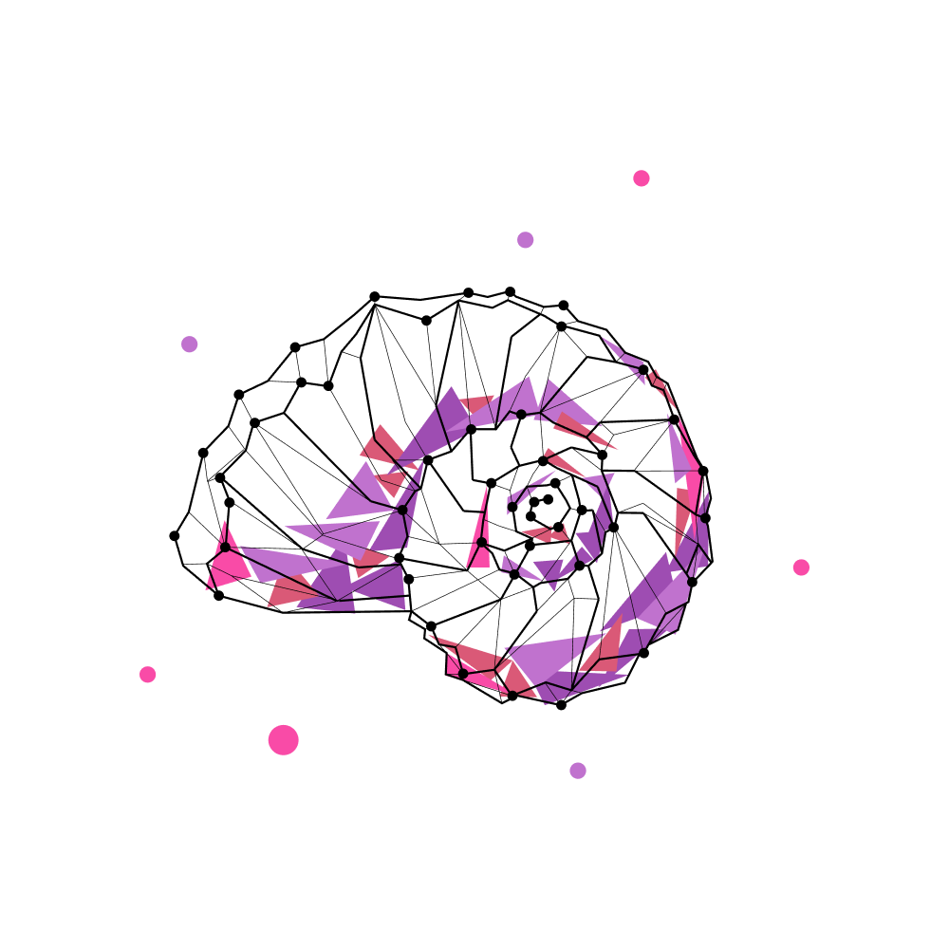
FEATURE SELECTION ANALYSIS
Graphical and Advanced Methods

Slide 7
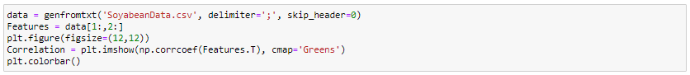
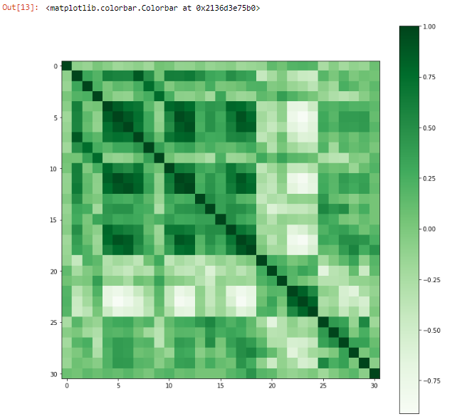
Correlation between numerical variables
Code :
Output :
We can observe a high correlation between some features of the dataset. But what we are interested in here is the correlation between row 0 (the yields) and columns 1 to 30 (the features).

Slide 8
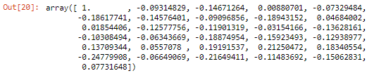
Ranking of variables based on their correlation
Code :
Output : Rank :
Note :
Rank | Index | Feature | Correlation
1 | 25 | RF_JUN | -0,24779908
2 | 27 | RF_AUG | -0,21649411
3 | 23 | LST_OCT | 0,21250472
4 | 22 | LST_SEP | 0,19191537
5 | 8 | LAI_JUL | -0,18943152
6 | 17 | ET_OCT | -0,18874954
7 | 5 | NDVI_OCT | -0,18617741
8 | 24 | LST_NOV | 0,18340554
9 | 18 | ET_NOV | -0,15923493
10 | 29 | RF_OCT | -0,15062831
11 | 2 | NDVI_JUL | -0,14671264
12 | 6 | NDVI_NOV | -0,14576401
13 | 20 | LST_JUL | 0,13709344
14 | 14 | ET_JUL | -0,13628161
15 | 19 | LST_JUN | -0,12938977
16 | 11 | LAI_OCT | -0,12577756
17 | 12 | LAI_NOV | -0,11901319
18 | 28 | RF_SEP | -0,11483692
19 | 15 | ET_AUG | -0,10308494
20 | 1 | NDVI_JUN | -0,09314829
21 | 7 | LAI_JUN | -0,09096856
22 | 30 | RF_NOV | 0,07731648
23 | 4 | NDVI_SEP | -0,07329484
24 | 26 | RF_JUL | -0,06649069
25 | 16 | ET_SEP | -0,06343669
26 | 21 | LST_AUG | 0,0557078
27 | 9 | LAI_AUG | 0,04684002
28 | 13 | ET_JUN | -0,03154166
29 | 10 | LAI_SEP | 0,01854406
30 | 3 | NDVI_AUG | 0,00880701
The ranking is based on the absolute value of the correlation between the target and the features because decorrelations are as important as correlations (an interesting feature is a feature that is farthest from 0, on the negative or positive side). Here, the feature that seems to be the most interesting for a model is the June rainfall feature which is however a decorrelation (the less it rains in June, the higher the yield).

Slide 9
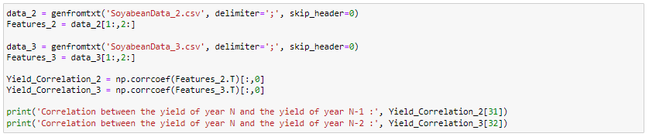
Correlation between the yield of year N and the yield of year N-1 / N-2
Code :
Output :
Note :
We notice that the correlation between the yields of years N and N-2 is strong and better than any other features.

Slide 10
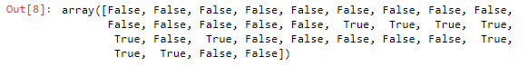
Feature selection : Advanced method (Variance threshold)
Code :
Output :
Features selected by the variance threshold : ET_JUL, ET_AUG, ET_SEP, ET_OCT, ET_NOV, LST_JUL, RF_JUL, RF_AUG, RF_SEP

Slide 11
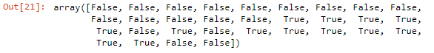
Feature selection for regression : Advanced method (SGDClassifier)
Code :
Output :
Features selected by SGDClassifier : ET_JUL, ET_AUG, ET_SEP, ET_OCT, ET_NOV, LST_JUL, LST_SEP, LST_OCT, LST_NOV, RF_JUN, RF_JUL, RF_AUG, RF_SEP

Slide 12
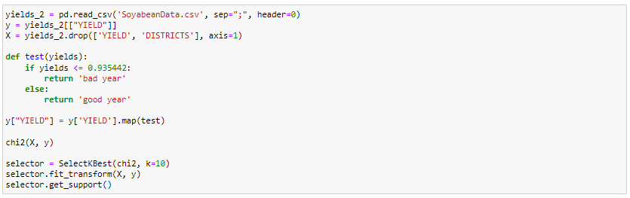
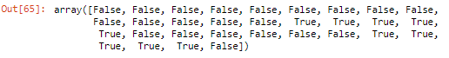
Feature selection for classification : Advanced method (Chi square)
Code :
Output :
Features selected by chi square : ET_JUL, ET_AUG, ET_SEP, ET_OCT, ET_NOV, RF_JUN, RF_JUL, RF_AUG, RF_SEP, RF_OCT

Slide 13

TIME SERIES ANALYSIS
Graphical Method

Slide 14
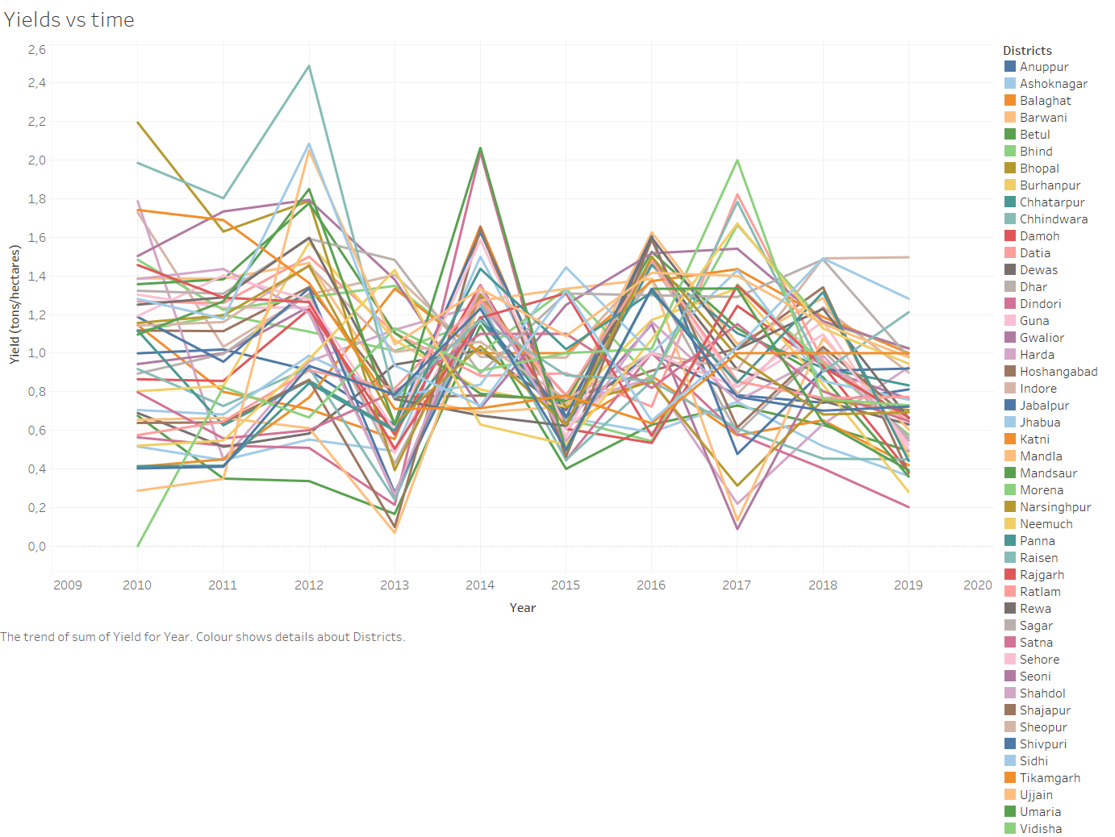
Yields vs time

Slide 15
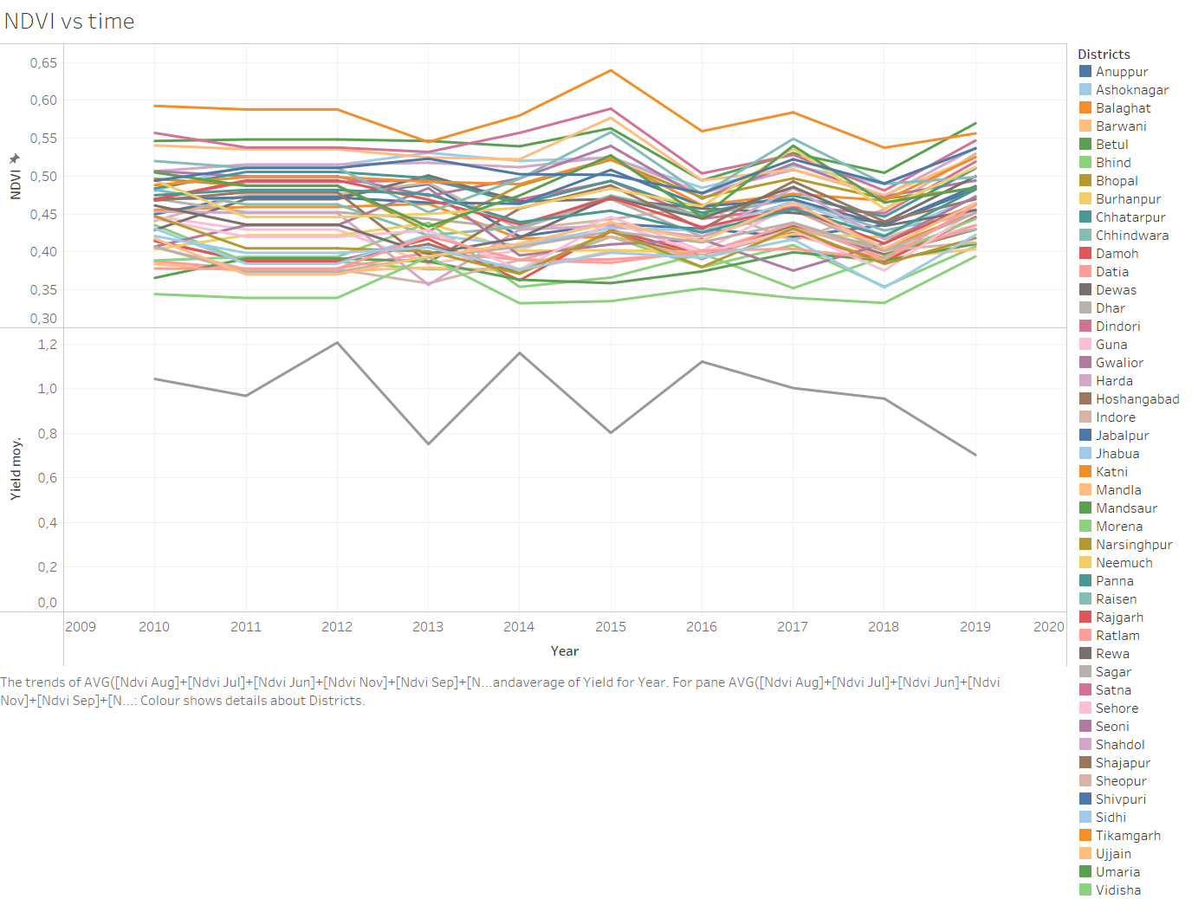
NDVI vs time

Slide 16
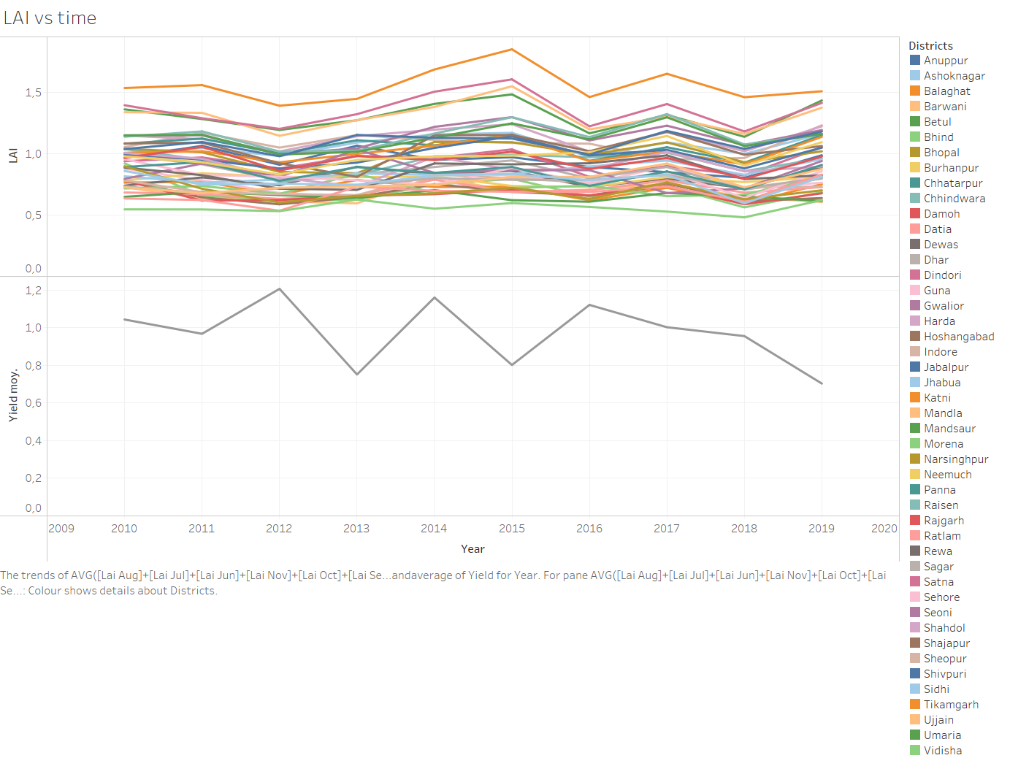
LAI vs time

Slide 17
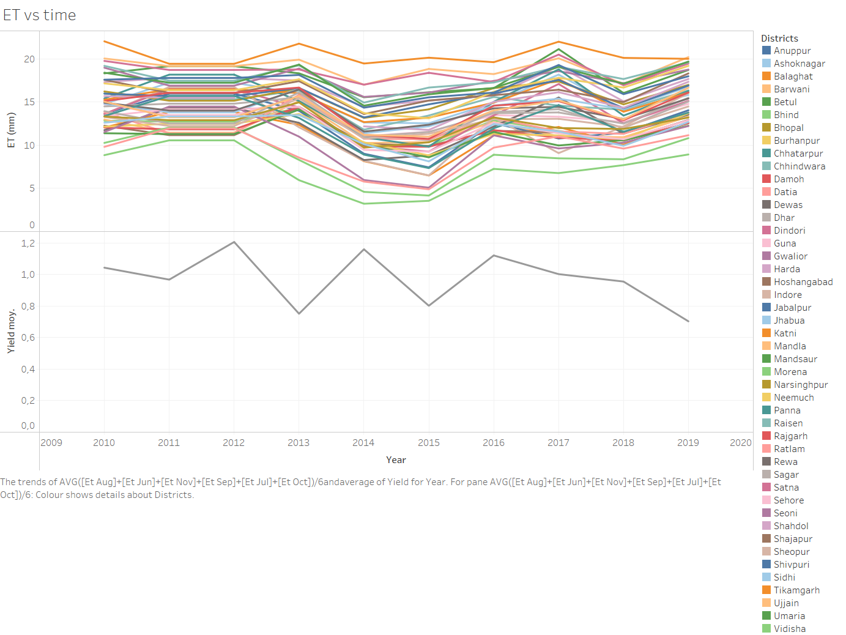
ET vs time

Slide 18
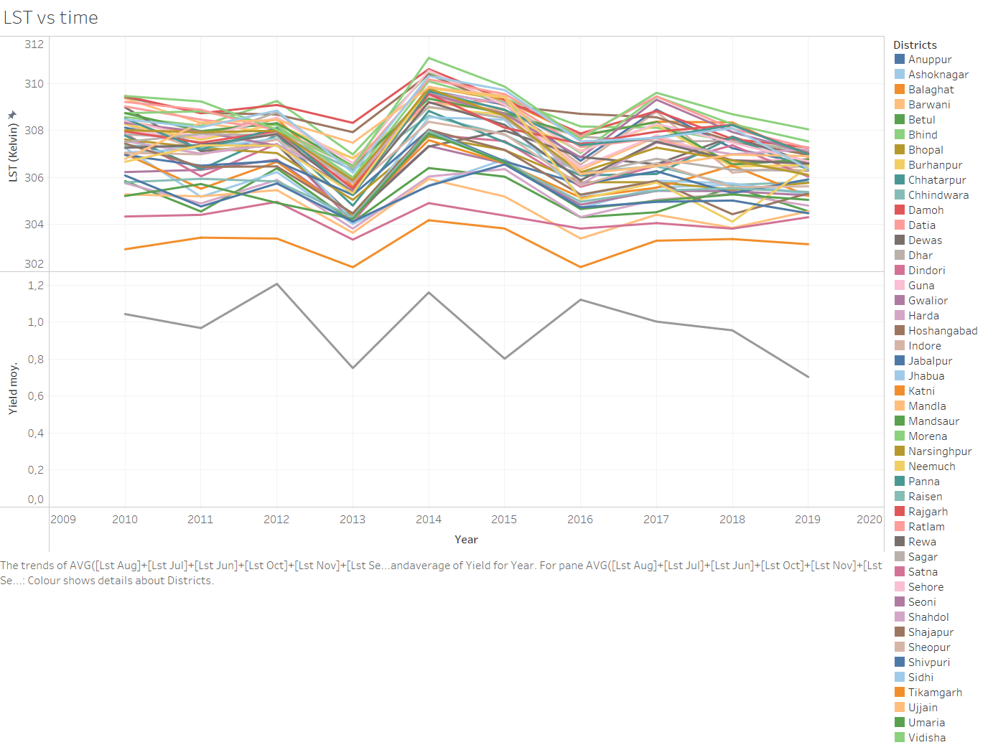
LST vs time

Slide 19
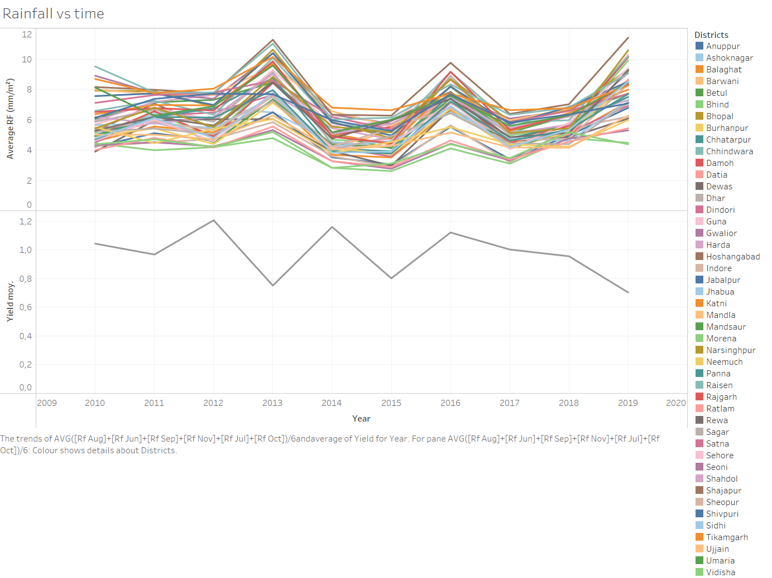
RF vs time

Slide 20
Observations
The yield is between 0 and 2.5 tons/hectare.
The yield seems similar to the one 2 years earlier (oscillation).
Rainfall appears to be decorrelated with yield.
The LST appears to correlate with yield.
There is not much difference between the yields of the different districts in the same year.

Slide 21

MACHINE LEARNING
Advanced Method

Slide 22

Usable models
With the data we have, we can use these models:
Regression models:
RidgeRegression
SVR(kernel='linear')
SVR(kernel='rbf')
EnsembleRegressors
Classification models :
K-nearest neighbors

Slide 23
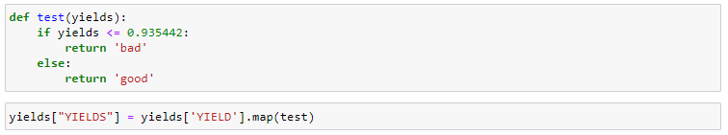
Selected model
Because of the weak correlations between the variables of the dataset (see Correlation slide), the regression models do not obtain satisfying scores.
For this reason, we will transform this regression problem (numerical value of yield) into a classification problem. To do this, we will predict whether the yield will be good (> the median yield) or bad (<= the median yield). With the following code, we can transform the problem :
We will therefore use the only usable classification model, which is the K-nearest neighbors model.

Slide 24
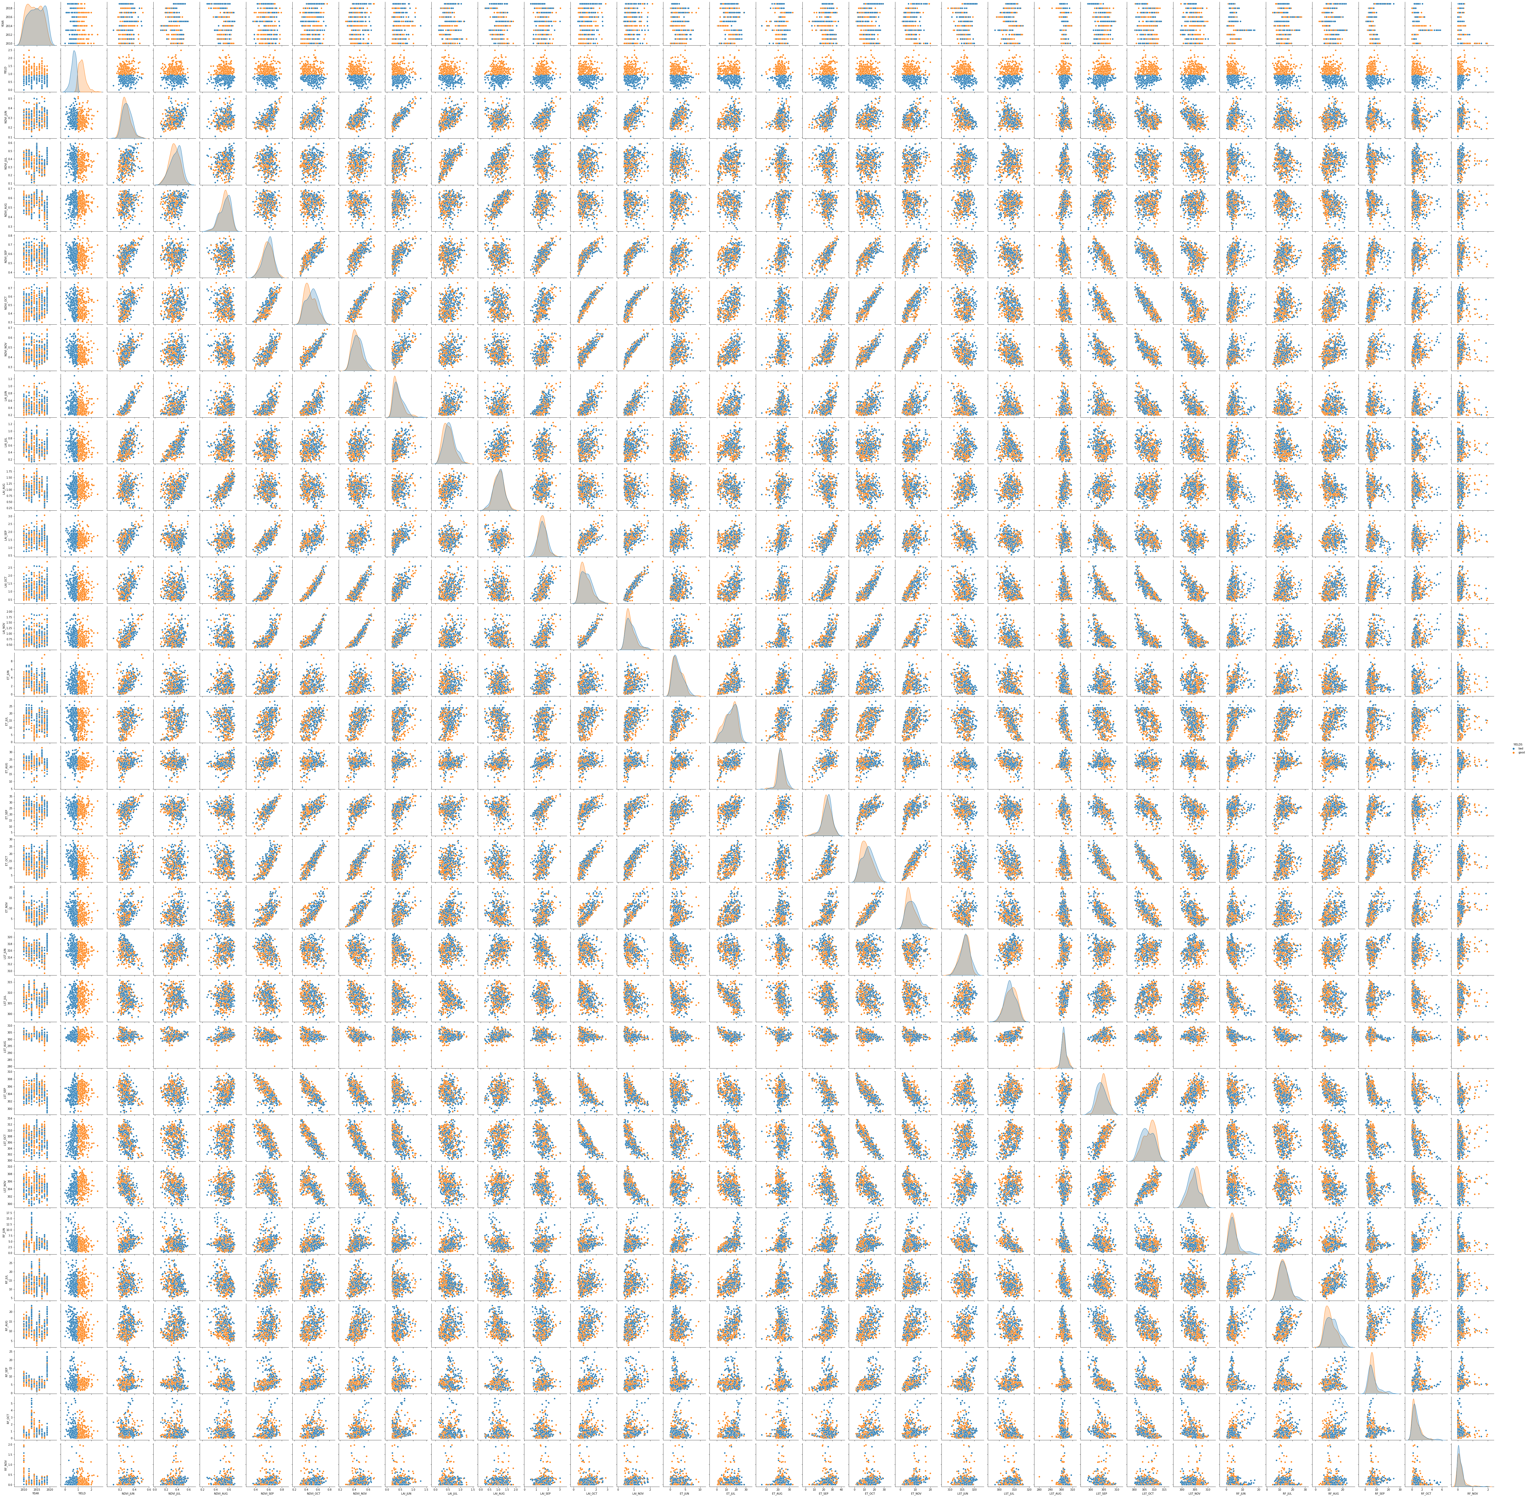
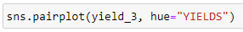
Why the K-nearest neighbors model could work ?
Code :
This code represents the features 2 to 2 and puts in orange the good yields (> than the yield median) and in blue the bad yields (<= to the yield median).
We can see that the years with a good yield and the one with a bad yield are sometimes grouped together. We can therefore use a model named K-nearest neighbors, this model tries to predict the correct class for the test data by calculating the distance between the test data and all the training points. Then select the K number of points which is closet to the test data.

Slide 25
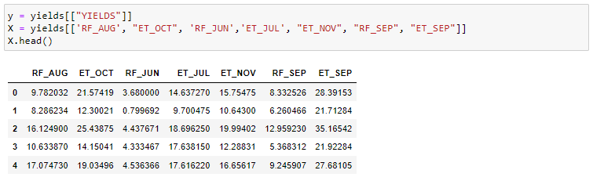
K-nearest neighbors model
Let's define two matrices, "y" is the one of the target (good or bad yield) and "X" is the one of the features we have selected previously by the Chi square method :
Let's then select the K-nearest neighbors model :

Slide 26
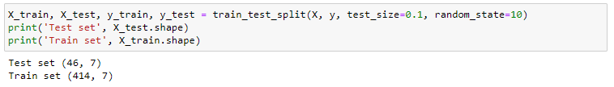
Train set, test set, training and first score
As their name indicates, the train set will be used to train our model while the test set will be used to evaluate it in order to know its accuracy. 90% of the data will be in the train set and 10% in the test set :
Let's train the model on the train set data :
Let's test the model on the test set data :
We obtain an accuracy of 67%, which means that 67% of the predictions (good or bad yield) are good. This is already a good score but we can improve it.

Slide 27
Hyperparameters selection using Cross validation
In order to improve the accuracy of the model, we will modify the hyperparameters of the K-nearest neighbors model, namely the number of neighbors to be considered as well as the type of distance (Euclidian or Manhattan). To do this, we will validate our model on different cuts (validation set) of the train set (cv=10) and then average the results obtained for each hyper-parameter value to determine the best model.
For example, here is the result of this cross validation for a number of neighbors equal to 3 and a Euclidean distance :

Slide 28
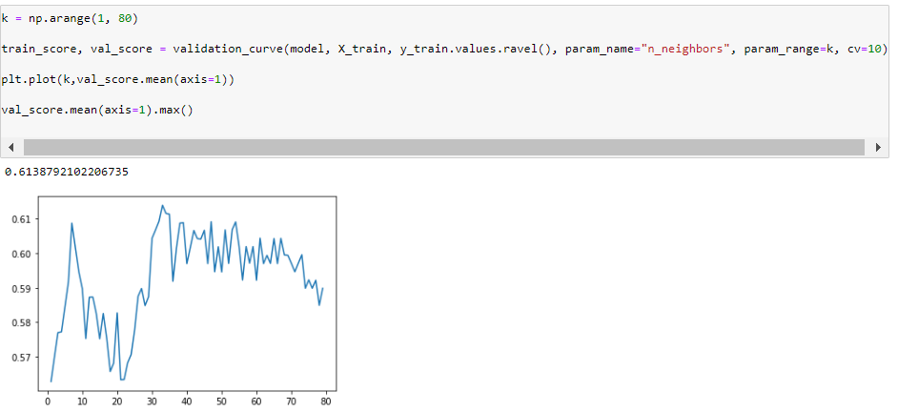
Validation Curve
Now, let's take the code from the previous slide and plot the results of the models for each value of the "neighbors" hyperparameter :
We therefore obtain this validation curve with the number of neighbors on the x-axis and the accuracy of the model on the validation sets on the y-axis. We can conclude that the most accurate model with a Euclidean distance is the one with a number of neighbors equal to 33 and an accuracy of 61,39% (on validation sets).

Slide 29
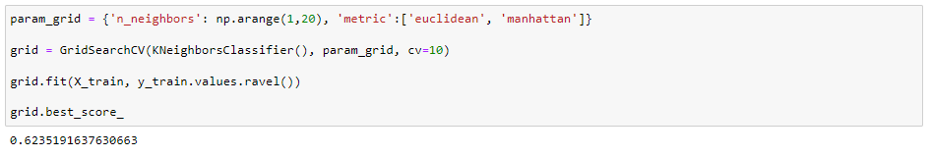
Hyperparameters selection using GridSearchCV + Cross validation
Now let's use GridSearchCV to determine the best model according to all parameters (number of neighbors and distance) :
The best model obtains an accuracy of 62.35% on the validation sets, which is better than our previous result.
Let's look at the hyperparameters of this model :
We can conclude that the best model has the following hyperparameters: a Manhattan distance and a number of neighbors of 7.

Slide 30
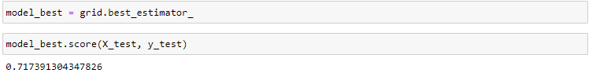
Model’s accuracy
Let’s save this model in a variable and determine its accuracy on the test set (these data have never been seen by the model) :
The model therefore predicts with an accuracy of 71.74% whether the yield will be good (> to the median of existing yield) or bad (<= to the median of existing yield).

Slide 31
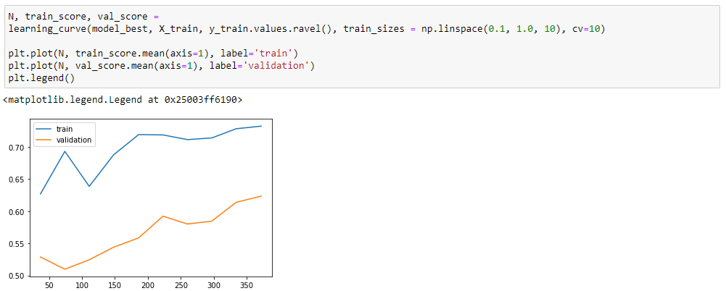
Learning Curve
The learning curve shows the evolution of the accuracy of the model as a function of the number of examples it is trained with. A curve converging to a limit shows that the model does not need any additional data, it has reached its learning maximum. On the contrary, if the curve does not seem to converge, it means that the model could improve its accuracy with more data.
Here we notice that the learning curves of the model do not converge. We can therefore conclude that the model could improve its accuracy if we gave it more data to train.

Slide 32
Best Model
Finally, by trying hundreds of combinations of features, I found a better K-nearest neighbors model using the previous year's yield as a feature and districts transformed into numerical values :
The hyperparameters of this model are the following :
This model makes a good prediction in 78.57% of cases

Slide 33
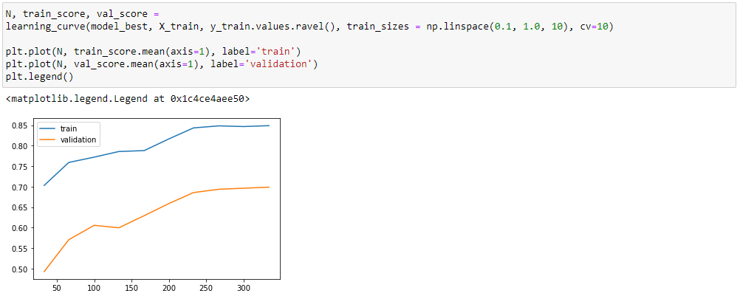
Best Model : Learning Curve
By observing the learning curves of this last model, we can see that they converge. This means that this model does not require any additional data :
This model is therefore more accurate than the previous one but has no room for improvement.

Slide 34
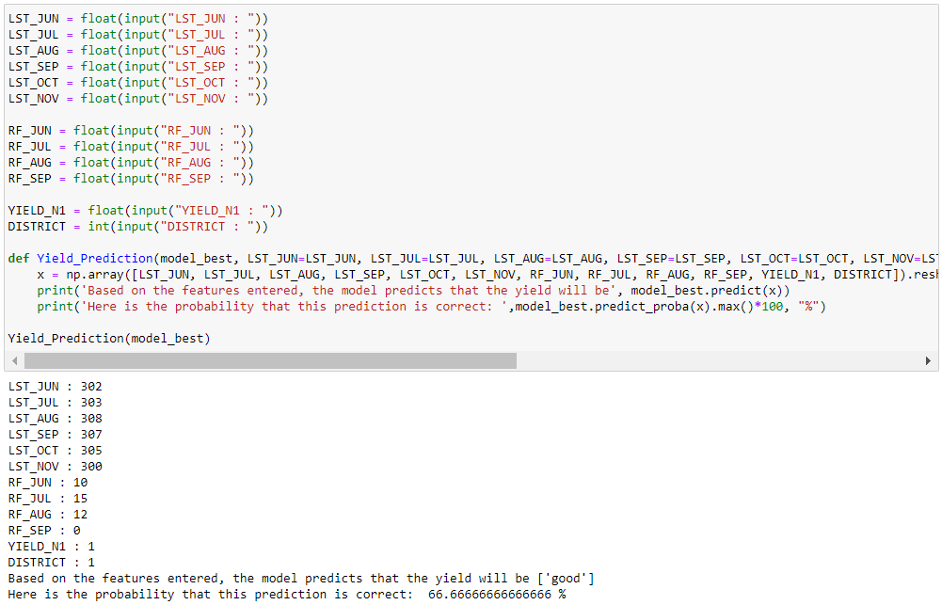
Function to predict yield using the best model
Finally, I made a function to predict whether the yield will be good or bad depending on the features entered by the user. (Warning : you have to indicate the district number (Anuppur = 0, ..., Vidisha =43). Thus, farmers will be able to use my machine learning model easily, know the prediction and the probability that it will come true.

Slide 35

RESOURCES

Slide 36
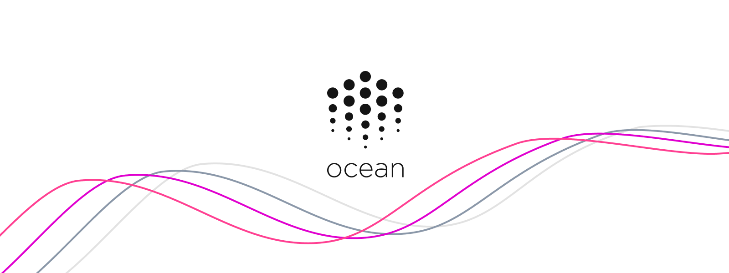
Publish on Ocean Market
The improved and cleaned dataset used for the best model is available on the Ocean Market and can be consumed for free at this address :
https://market.oceanprotocol.com/asset/did:op:bca6f2c5ccb7d2af6527b194d6fd6792c76e81cedacebb00d16b8cd66f73b7dc
36

Slide 37
GitHub repository
This report, the 2 machine learning models, the 3 datasets and the notebook of the feature analysis can be found in the following GitHub repository :
https://github.com/Demoniarc/data-challenge-2.git

